Slide 1








Artificial Intelligence
(CS-401)
Lecture 2:
Intelligent Agents
Mafaza Mohi
mafaza.mohi@nu.edu.pk

Slide 2


Intelligent Agents
❑
Agents and environments
❑
Rationality
❑
PEAS (Performance measure,
Environment, Actuators, Sensors)
❑
Environment types
❑
Agent types
3

Slide 3
Agents
An agent is anything that can be viewed as perceiving its
environment through sensors and acting upon that
environment through actuators.
Human agent: Eyes, ears, and other organs for sensors;
hands, legs, mouth, and other body parts for actuators
Robotic agent: Cameras and infrared range finders for
sensors; various motors for actuators.
Software agent: Software agent is a computer program
that
acts for a user or other program: an agreement to act on
one's behalf.
4

Slide 4
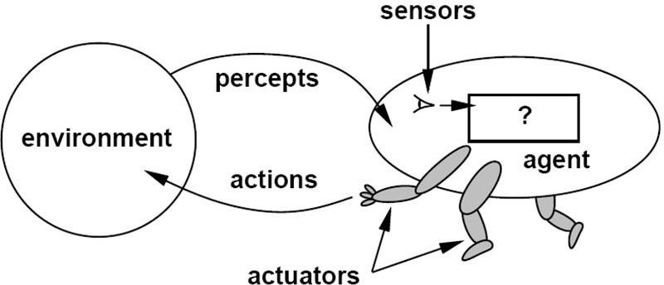
Agents
and
Environments
The agent function maps from percept
[f: P* → A]
histories to actions:
The agent program runs on the physical
produce f
Agent = Architecture + Program
architecture to
5

Slide 5
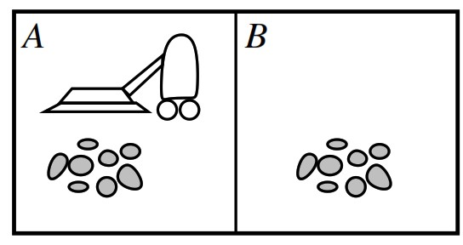
Vacuum-cleaner
world
Percepts: location and contents,
e.g.,
[A,
Dirty]
Actions: Left, Right, Suck, DoNothing
6

Slide 6
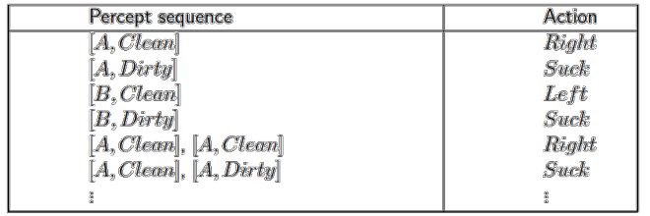
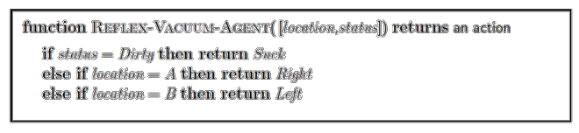
A vacuum-cleaner Agent
Tabulation
of
an
agent
function
of
the
vacuum-cleaner
7

Slide 7
Intelligent Agents
❑
Agents and environments
❑
Rationality
❑
PEAS (Performance measure,
Environment, Actuators, Sensors)
❑
Environment types
❑
Agent types
8

Slide 8
Rational Agents
An agent should strive to "do the right thing", based on what
can perceive and the actions it can perform. The right action
is the one that will cause the agent to be most successful.
it
Performance measure: an objective criterion for success of an agent's behavior.
E.g., performance measure of a vacuum-cleaner agent could
be amount of dirt cleaned up, amount of time taken, amount
of electricity consumed, amount of noise generated, etc.
9

Slide 9
Rational Agents
Rational Agent: For each possible percept
sequence, a rational agent should select an action
that is expected to maximize its performance
measure, given the evidence provided by the
percept sequence
and
whatever
built-in
knowledge
the
agent
has.
10

Slide 10
Rational Agents
Rationality is distinct
knowing with infinite
from omniscience (all-
knowledge.
Agents can perform actions in order to modify
percepts so as to obtain useful information
(information gathering, exploration, learn).
future
An agent is autonomous if its behavior is determined
by its own experience (with ability to learn and adapt).
11

Slide 11
Intelligent Agents
❑
Agents and environments
❑
Rationality
❑
PEAS (Performance measure,
Environment, Actuators, Sensors)
❑
Environment types
❑
Agent types
12

Slide 12
PEAS
When designing a rational/intelligent agent, we keep in mind
PEAS.
PEAS: Performance measure, Environment, Actuators,
Sensors
Consider, e.g., the task of designing
an
automated
taxi
driver:
–
–
–
–
Performance
Environment
Actuators
Sensors
measure
13

Slide 13
PEAS
Agent: automated taxi driver
•
Performance measure: Safe, fast, legal, comfortable trip,
maximize profits
Environment: Roads, other traffic, people and objects in/around the street
Actuators: Steering wheel, accelerator, brake, signal, horn
•
•
•
Sensors: Cameras, sonar,
engine sensors, keyboard
speedometer, GPS,
odometer,
14

Slide 14
PEAS
Agent: Medical diagnosis system
•
Performance measure: Healthy patient, minimize
lawsuits
costs,
•
•
Environment: Patient, hospital, staff
Actuators: Screen display
treatments, referrals)
Sensors: Keyboard (entry
patient's answers)
(questions, tests, diagnoses,
•
of symptoms, findings,
15

Slide 15
PEAS
Agent: Part-picking robot
•
•
•
•
Performance measure: Percentage of parts in
correct
bins
Environment: Conveyor belt with parts,
bins
Actuators: Jointed
arm and hand
Sensors:
Camera,
joint
angle
sensors
16

Slide 16
PEAS
Agent: Interactive English tutor
•
•
•
Performance measure: Maximize student's score on
Environment: Set of students
test
Actuators: Screen display
corrections)
(exercises,
suggestions,
•
Sensors: Keyboard
17

Slide 17
Intelligent Agents
❑
Agents and environments
❑
Rationality
❑
PEAS (Performance measure,
Environment, Actuators, Sensors)
❑
Environment types
❑
Agent types
18

Slide 18
Environment Types
•
1) Fully observable vs. 2) Partially observable
•
Sensors capture all relevant information from the environment
•
3) Deterministic vs. 4) Stochastic (non-
deterministic)
•
Changes in the environment are predictable
•
5) Episodic vs. 6) Sequential
(non-episodic)
•
Independent perceiving-acting episodes
•
7) Static vs. 8) Dynamic
•
No changes while the agent is “thinking”
•
9) Discrete vs. 10) Continuous
•
Limited number of distinct percepts/actions
•
11) Single vs. 12) Multiple agents
•
•
Interaction and collaboration among agents
Competitive, cooperative

Slide 19
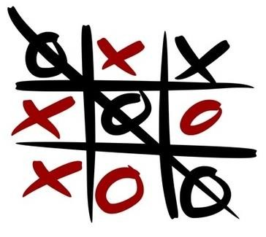

Environment Types
❖Fully observable (vs. partially observable):
An agent's
sensors can measure
all
relevant
aspects
of
the
environment
at
each
point
in
time.
Tic Tac Toe is
Fully
Observable. Cards are Partially Observable.
20

Slide 20

Environment Types
Deterministic (vs. stochastic): The next state of the
❖
environment is completely determined
by
the
current
state
and
the
action
executed
by
the
agent.
Vacuum is deterministic. Taxi driver
is stochastic.
21

Slide 21
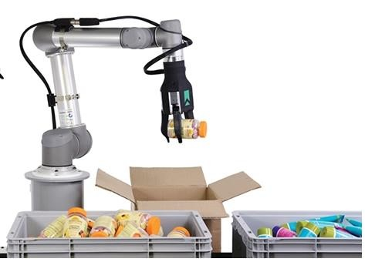
Environment Types
❖Episodic (vs. sequential): The agent's experience is divided into atomic "episodes" (each episode consists of the agent perceiving and then performing a single action), and the choice
of
action
in
each
episode
depends
only
on
the
episode
itself.
Robot
is Episodic. Taxi driver
is sequential.
22

Slide 22
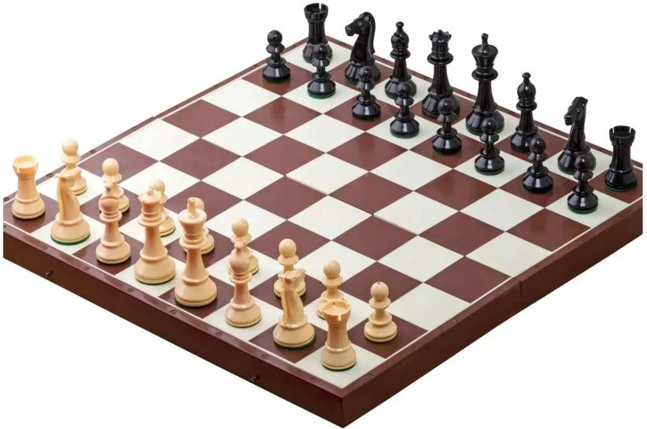
Environment Types
❖Static (vs. dynamic): The environment is unchanged while
an agent is thinking. (The environment is semidynamic if
the
time
environment itself does not change with the
passage
of
but
the
agent's
performance
score
does).
Taxi driver is dynamic. Chess is
static.
23

Slide 23
Environment Types
❖Discrete (vs. continuous): A
limited
number
of
distinct,
clearly
defined percepts
and
actions.
Chess has a finite number of
distinct
states. thus it is discrete;
however the Taxi-driving is not.
24

Slide 24
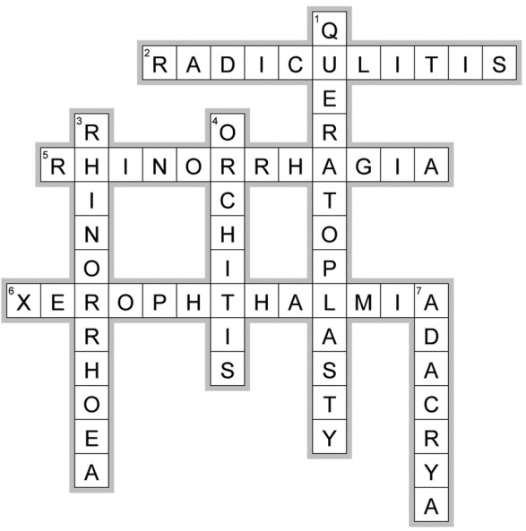
Environment Types
❖Single agent (vs.
multiagent):
An
agent
operating
by
itself
in
an
environment.
Crossword is
environment.
Single agent, while Chess is a multi-agent
25

Slide 25
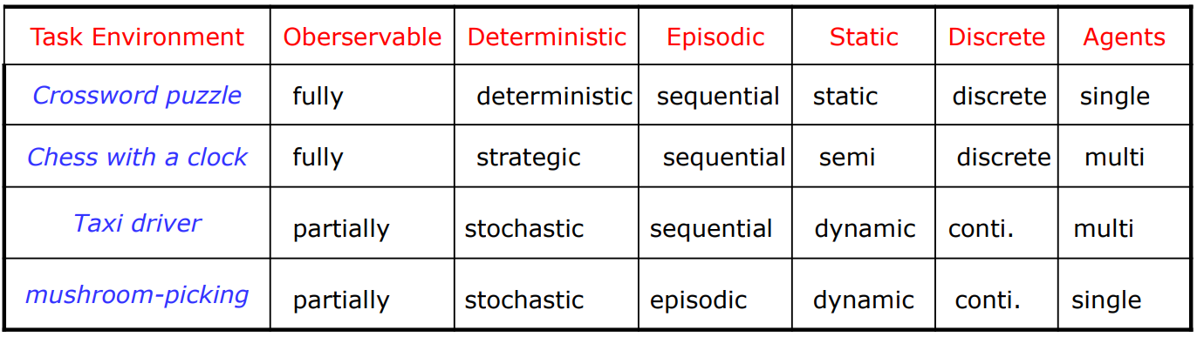
Environment
Types
•
The environment
type largely
determines the agent design
•
The real world is
(of course) partially observable,
stochastic, sequential, dynamic, continuous, multi-agent
26

Slide 26
Intelligent Agents
❑
Agents and environments
❑
Rationality
❑
PEAS (Performance measure,
Environment, Actuators, Sensors)
❑
Environment types
❑
Agent types
27

Slide 27
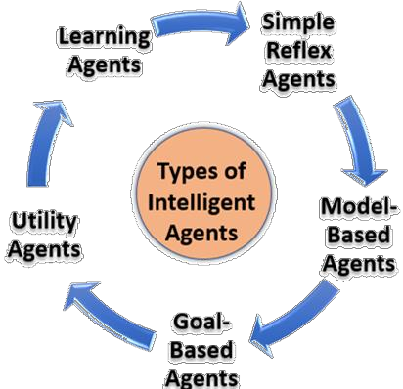
Agent Types
Agents can be divided in to five (05) basic types
according to the degree of perceived
intelligence
and capacity to change the environment:
–
Simple reflex agents
–
Model-based reflex agents
–
Goal-based agents
–
Utility-based agents
–
Learning Agents
28

Slide 28
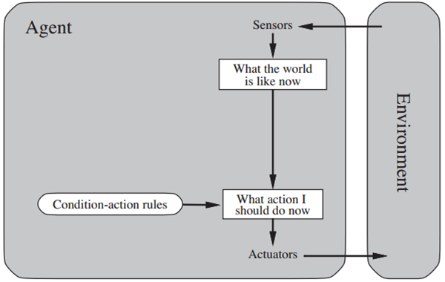
Simple Reflex Agents
The agent selects an action(s) based on the current
precept and conditions, ignoring
the
rest
of
the
precept history
(previous state).
if
x
happens,
do
y
e.g.,
alarm
clock
29

Slide 29
Simple Reflex Agents
•
•
Very limited
Intelligence
No Knowledge/Perception
next state
about
the previous or
•
•
Operates in Partially Observable
Environments
Infinite
loops
are
unavoidable
30

Slide 30
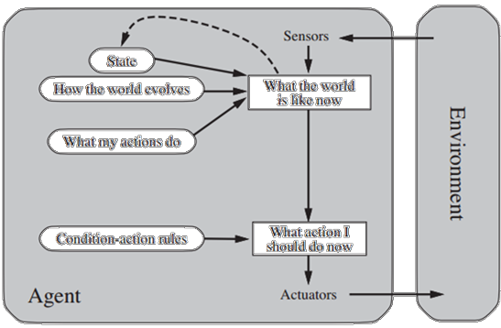
Model-based Reflex Agents
The agent decides its action(s) based on a predefined
set of condition-action rules.
Depending on the
are appropriate.
State is evaluated
previous state.
state of the world, different
actions
in
terms
of
how
it
changed
from
the
e.g., A Roomba
Cleaner Robot, a
telephone
operator/answering
machine.
31

Slide 31
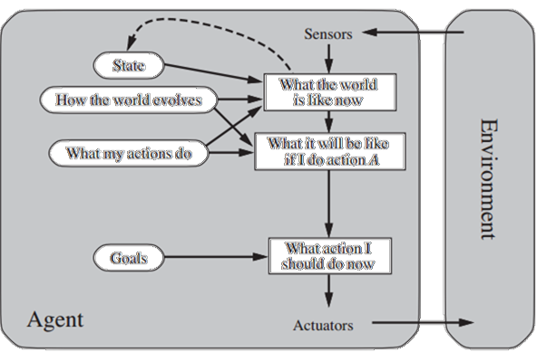
Goal-based Agents
The agent decides its action(s) based on a known
goal.
These agents have all
of
of
the above and goal.
Involves
states.
consideration
the
previous
and
future
e.g., a GPS system
finding a path to
certain destination.
32

Slide 32
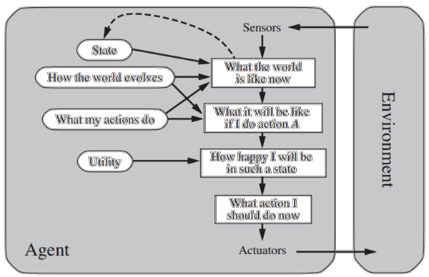
Utility-based Agents
The agent decides its action(s) based on utilities/
preferences.
Utility function to decide
which
world
state
(Optimality)
is
better
for
an
agent.
e.g., A GPS
system finding
a
shortest/fastest/sa
fer path to certain destination.
33

Slide 33
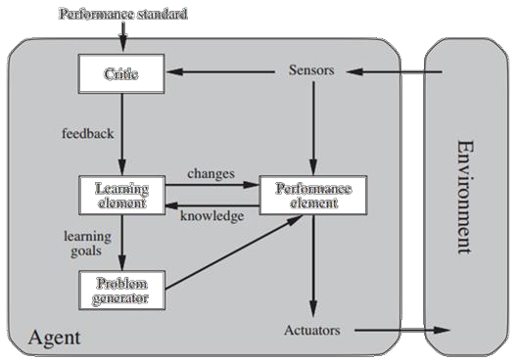
Learning Agents
The agent adapts its action(s) based on feedback (not only sensors).
Learning element - responsible for making improvements from past
events.
Performance element - what we have up to now considered to be the entire agent. Takes percepts and then decides on actions.
Critic - gives the learning element feedback on how the performance element is doing and if it needs to be modified.
Problem generator - it suggests actions that lead
informative experiences.
to
new and
e.g., human agent
34

Slide 34
Summary
Agents interact with environments through actuators and sensors
The agent function describes what the agent does in all
circumstances.
The performance measure evaluates the environment sequence.
A perfectly rational agent maximizes expected performance.
Agent programs implement (some) agent functions PEAS
descriptions define task environments.
Environments are categorized along several dimensions:
•
•
•
•
•
•
•
Observable? deterministic? episodic? static? discrete?
agent?
single-
•
Several basic agent architectures exist:
•
Simple Reflex, Model based, goal-based, utility-based,
Learning

